Slide 1

Computing Algorithms Lecture 10: Transform and Conquer
By: Dr. Mohamed Moheeb

Slide 2
Agenda
Introduction
Presorting
Balanced search tree
Heap sort

Slide 3

Introduction

Slide 4
That are based on the idea of transformation. We call this general technique transform-and-conquer because these methods work as two-stage procedures.
The transformation stage, the problem’s instance is modified to be, for one reason or another, more amenable to solution.
The conquering stage, it is solved

Slide 5
Presorting

Slide 6
Presorting
Presorting is an old idea in computer science.
In fact, interest in sorting algorithms is due, to a significant degree, to the fact that many questions about a list are easier to answer if the list is sorted.
The time efficiency of algorithms that involve sorting may depend on the efficiency of the sorting algorithm being used.

Slide 7
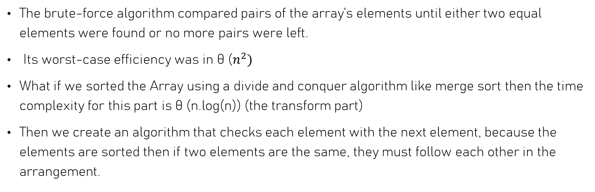
Checking element uniqueness in an array
The brute-force algorithm compared pairs of the array’s elements until either two equal elements were found or no more pairs were left.
Its worst-case efficiency was in θ ($n^{2})$
What if we sorted the Array using a divide and conquer algorithm like merge sort then the time complexity for this part is θ (n.log(n)) (the transform part)
Then we create an algorithm that checks each element with the next element, because the elements are sorted then if two elements are the same, they must follow each other in the arrangement.

Slide 8
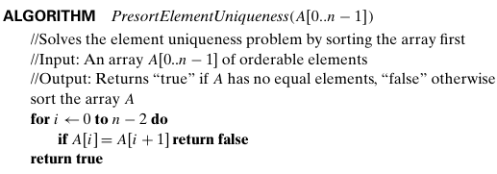
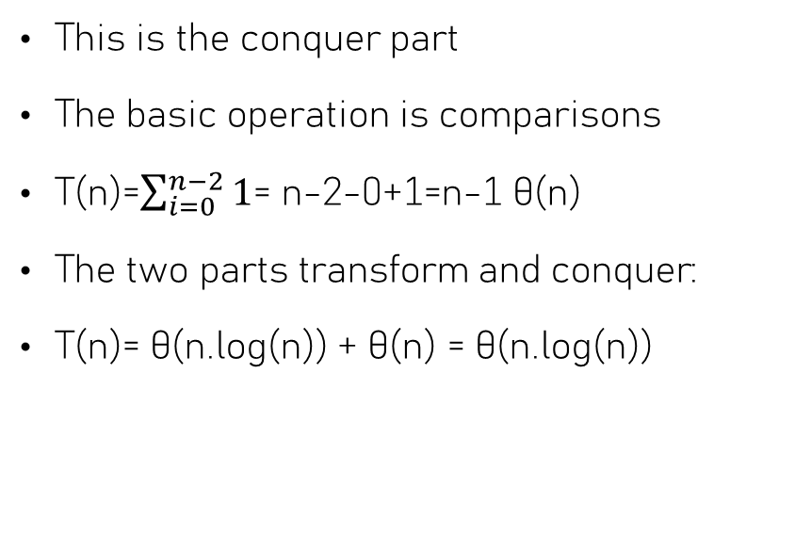
Checking element uniqueness in an array
This is the conquer part
The basic operation is comparisons
T(n)=$\sum_{i=0}^{n−2}{1}$= n-2-0+1=n-1 θ(n)
The two parts transform and conquer:
T(n)= θ(n.log(n)) + θ(n) = θ(n.log(n))

Slide 9
Balanced Binary Search Tree

Slide 10
Binary search trees
Binary search tree (BTS) is a tree with at most two children nodes for each parent node
For any given node, all values in its left subtree must be smaller, and all values in its right subtree must be larger
Why use tree not just arrays or linked lists?
Arrays: While a sorted array allows for O(log n) search, inserting or deleting an element is slow (O(n)) because you have to shift all other elements.
Linked Lists: These allow for fast insertion once you find the spot, but searching is always O(n) because you have to traverse them linearly.
BST Advantage: BST aims to provide the "best of both worlds": efficient searching and efficient dynamic updates (insertions/deletions).

Slide 11
Balanced Binary Search Tree
In a randomly built tree, the height is logarithmic, making search, insertion, and deletion very efficient θ(log(n)))
But if the elements are inserted in ascending or descending order the time complexity is θ(n)
How to solve this problem ? by making creating a balanced binary tree
A Balanced (BTS) is method used to ensure the height of the tree doesn’t exceed a certain height on both sides
There is two types of algorithm:
AVL Tree
2-3 Tree

Slide 12
AVL tree
An AVL Tree (named after its inventors Adelson-Velsky and Landis) is a self-balancing Binary Search Tree (BST).
It was the first data structure of its kind to be developed, specifically designed to address the "skewing" problem where a standard BST can become inefficient and act like a linked list.
The defining characteristic of an AVL tree is that it maintains a strict balance during every insertion and deletion. This ensures that the tree height remains logarithmic relative to the number of nodes, guaranteeing that operations like search, insertion, and deletion ϴ(log(n))

Slide 13
AVL Tree
an AVL tree is the Balance Factor (BF). For every node in the tree, the balance factor is calculated
Balance Factor = Height of Left Subtree – Height of Right Subtree
To remain "balanced," an AVL tree enforces a strict rule: the balance factor of every node must be either -1, 0, or +1.
If the BF of any node becomes +2 or -2 after an update, the tree is considered "unbalanced.“
The tree must then perform a rotation to restore its balance.
To restore balance without breaking the BST property (Left < Parent < Right), the tree performs one of four rotations.

Slide 14
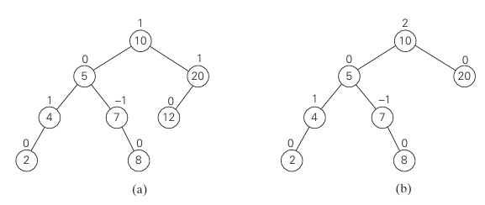
AVL Tree

Slide 15
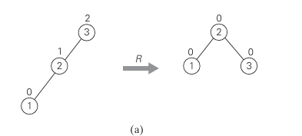
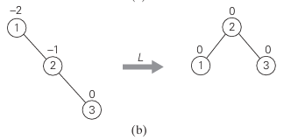
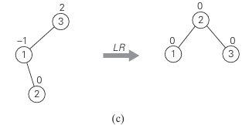
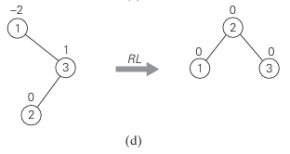
AVL tree

Slide 16
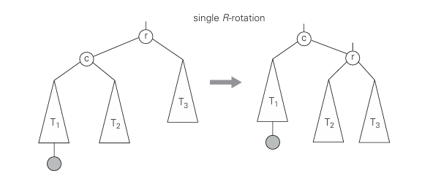
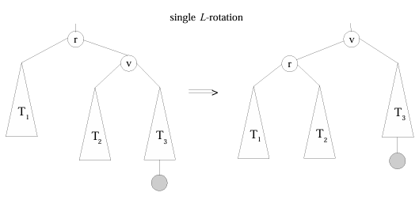
AVL Tree

Slide 17
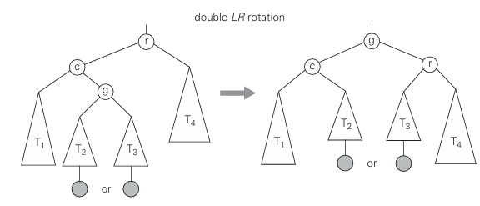
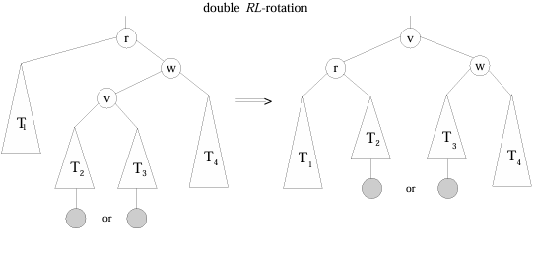
AVL tree

Slide 18
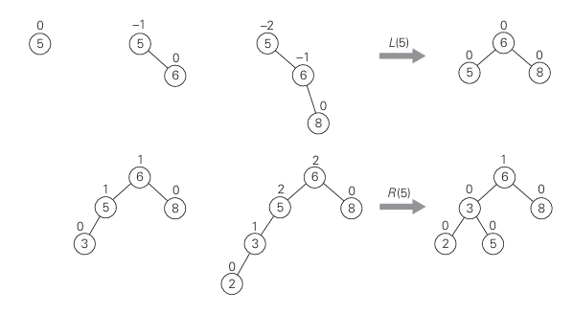
AVL Example
Construction of an AVL tree for the list 5, 6, 8, 3, 2, 4, 7 by successive insertions.

Slide 19
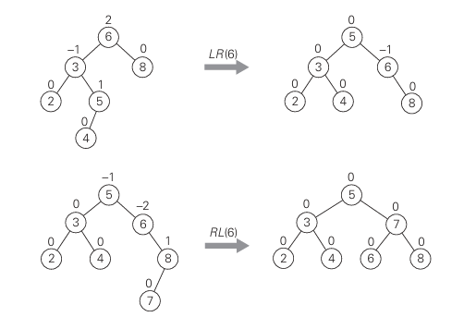
AVL Example
Construction of an AVL tree for the list 5, 6, 8, 3, 2, 4, 7 by successive insertions.

Slide 20
2-3 tree
It is also used to balance a search tree is to allow more than one key in the same node of such a tree
A 2-3 tree is a tree that can have nodes of two kinds:2-nodes and 3-nodes.
A 2-node contains a single key K and has two children:
the left child serves as the root of a subtree whose keys are less than K
the right child serves as the root of a subtree whose keys are greater than K.
In other words, a 2-node is the same kind of node we have in the classical binary search tree.)

Slide 21
2-3 tree
It is also used to balance a search tree is to allow more than one key in the same node of such a tree
A 2-3 tree is a tree that can have nodes of two kinds:2-nodes and 3-nodes.
A 2-node contains a single key K and has two children:
the left child serves as the root of a subtree whose keys are less than K
the right child serves as the root of a subtree whose keys are greater than K.
In other words, a 2-node is the same kind of node we have in the classical binary search tree.)

Slide 22
2-3 tree
A 3-node contains two ordered keys K1 and K2 (K1 < K2) and has three children.
The leftmost child serves as the root of a subtree with keys less than K1,
the middle child serves as the root of a subtree with keys between K1 and K2,
the rightmost child serves as the root of a subtree with keys greater than K2

Slide 23
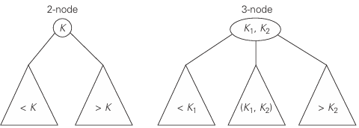
2-3 tree

Slide 24
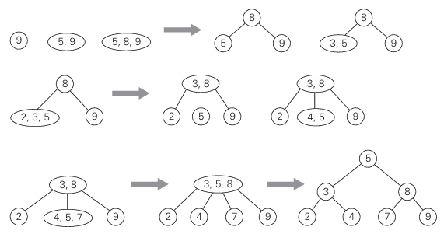
2-3 tree Example
Construction of a 2-3 tree for the list 9, 5, 8, 3, 2, 4, 7

Slide 25
Heap sort

Slide 26
Heap
A heap can be defined as a binary tree with keys assigned to its nodes, one key per node, provided the following two conditions are met:
The shape property—the binary tree is essentially complete (or simply complete), i.e., all its levels are full except possibly the last level, where only some rightmost leaves may be missing.
The parental dominance or heap property—the key in each node is greater than or equal to the keys in its children.

Slide 27
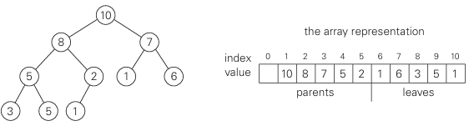
Heap

Slide 28
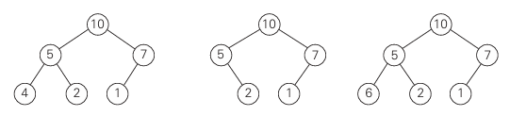
Which one is heap ?

Slide 29
Important properties of heaps
There exists exactly one essentially complete binary tree with n nodes. Its height is equal to [log2 n].
The root of a heap always contains its largest element.
A node of a heap considered with all its descendants is also a heap.

Slide 30
Important properties of heaps
4. A heap can be implemented as an array by recording its elements in the top-down, left-to-right fashion. It is convenient to store the heap's elements in positions 1 through n of such an array, leaving H[0] either unused or putting there a value that is greater than every element in the heap:
the parental node keys will be in the first [n/2] positions of the array, while the leaf keys will occupy the last [n/2] positions.
the children of a key in the array's parental position i (1 ≤ i ≤ [n/2]) will be in positions 2i and 2i + 1, and, correspondingly, the parent of a key in position i (2 ≤ i ≤ n) will be in position [i/2].

Slide 31
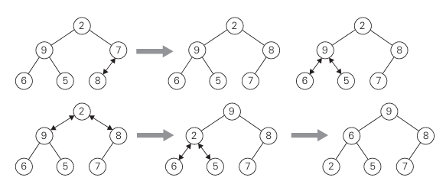
Heap Bottom Up

Slide 32
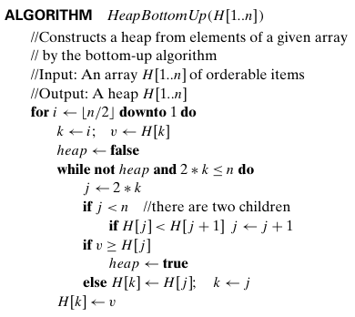
Heap-bottom up
Let’s trace on this list 2, 9, 7, 6, 5, 8 using array this time

Slide 33
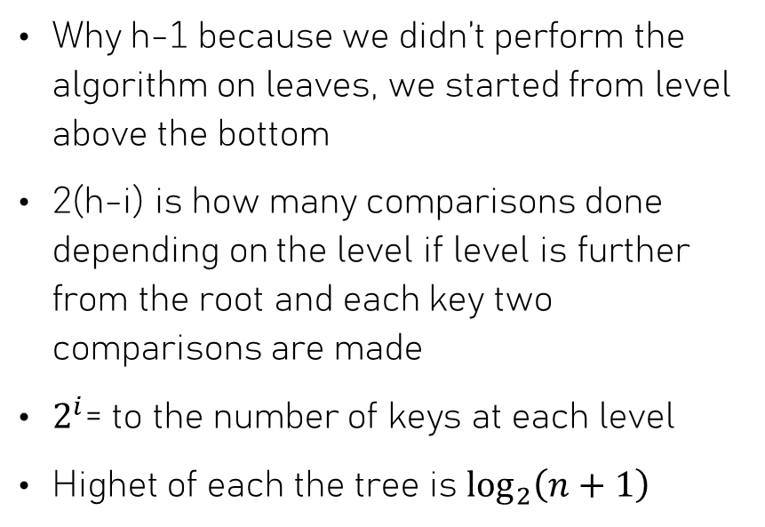

Heap-bottom up time complexity
T(n)= $\overset{h−1}{\underset{i=0}{\sum{\underset{level i keys}{\sum{2\left(h−i\right)}}}}} =\overset{h−1}{\underset{i=0}{\sum{2\left(h−i\right)2^{i}}}}$
$$=2\left(n−\log_{2}⁡\left(n+1\right)\right)$$
Why h-1 because we didn’t perform the algorithm on leaves, we started from level above the bottom
2(h-i) is how many comparisons done depending on the level if level is further from the root and each key two comparisons are made
$2^{i}$= to the number of keys at each level
Highet of each the tree is $\log_{2}⁡\left(n+1\right)$

Slide 34
Top-down heap construction
Initialize: Start with an empty heap.
Insert: For each element in the input set:
Place the element at the first available leaf position (the end of the heap array) to maintain the complete binary tree property.
Up-Heapify (Sift-Up): Compare the newly added element with its parent. If it violates the heap property (e.g., it is larger than its parent in a max-heap), swap them.
Continue swapping the element with its parent until it reaches the root or its correct position where the heap property is satisfied.
Repeat: Repeat these steps until all input elements are processed
Time complexity O(nlogn)
This is because each of the insertions can take up to log(n) time as the element "bubbles up" the height of the tree.

Slide 35
Top-down heap construction (successive key insertions)
Let’s trace on this list 2, 9, 7, 6, 5, 8 using the same array
[2]
[2,9] → [9,2]
[9,2,7]
[9,2,7,6]→[9,6,7,2]
[9,6,7,2,5]
[9,6,7,2,5,8]→[9,6,8,2,5,7]

Slide 36
Maximum Key Deletion algorithm
Algorithm
Step 1 Exchange the root’s key with the last key K of the heap.
Step 2 Decrease the heap’s size by 1.
Step 3 “Heapify” the smaller tree by sifting K down the tree exactly in the same way we did it in the bottom-up heap construction algorithm. That is, verify the parental dominance for K: if it holds, we are done; if not, swap K with the larger of its children and repeat this operation until the parental dominance condition holds for K in its new position.
The efficiency of deletion is determined by the number of key comparisons needed to “heapify” the tree after the swap has been made and the size of the tree is decreased by 1. Since this cannot require more key comparisons than twice the heap’s height, the time efficiency of deletion is in O(log n)

Slide 37
Heap sort
Stage 1 (heap construction): Construct a heap for a given array. (Heap-bottom up)
Stage 2 (maximum deletions): Apply the root-deletion operation n − 1 times to the remaining heap.

Slide 38
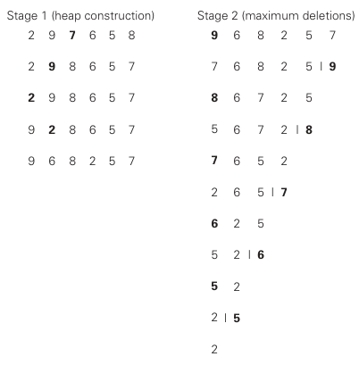
Heap sort

Slide 39
Heap sort time complexity
Stage 1 : As we just broke down in the previous math, we build the initial heap from an unordered array using the bottom-up approach. Time Complexity: O(n).
Stage 2: As we stated before to delete one element and heapifiy the list will take O(log(n)) and since we are going to heapifiy the list n times then the total complexity is O(nlog(n))
By using both stages the final output is time complexity for heap sort is O(nlog(n))

